Slide 1
Microprocessor Architecture ECE4375 / ECE 5375
Dr. Argenis Bilbao
Spring 2026

Slide 2
Presentation Outline
Register File
The ALU/Function Unit
  Data flow example
Instruction Decoder
  Condition code bits
Instruction Pipelining Examples

Slide 3
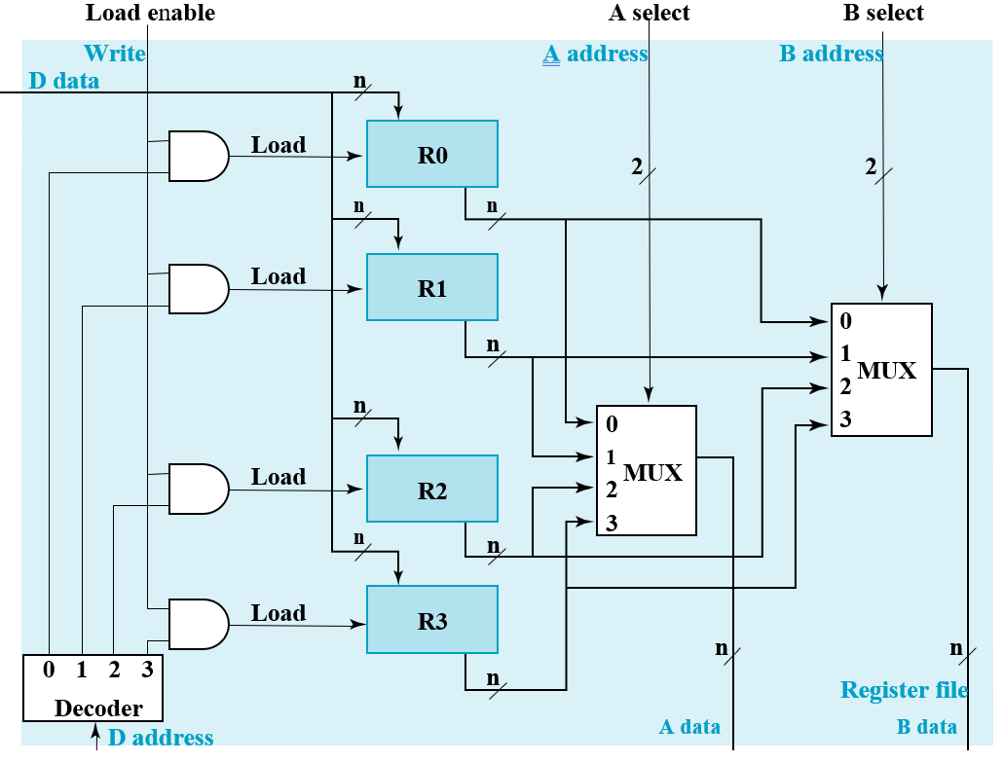
The Register File
Contains all the general-purpose registers
Provides means of
addressing registers
for reading and writing
Data input bus
Data input address
bus
One load enable
signal
Two data output buses
Two data output
busses

Slide 4
The Instruction Decoder
What is it?
A combinational logic circuit.
Can be implemented as a ROM Memory device.
What does it do?
Stores the address of the start of the microcode for each one of the instructions (CISC).
Generates a control word from the input instruction to control the state of the datapath for instruction execution (RISC).

Slide 5
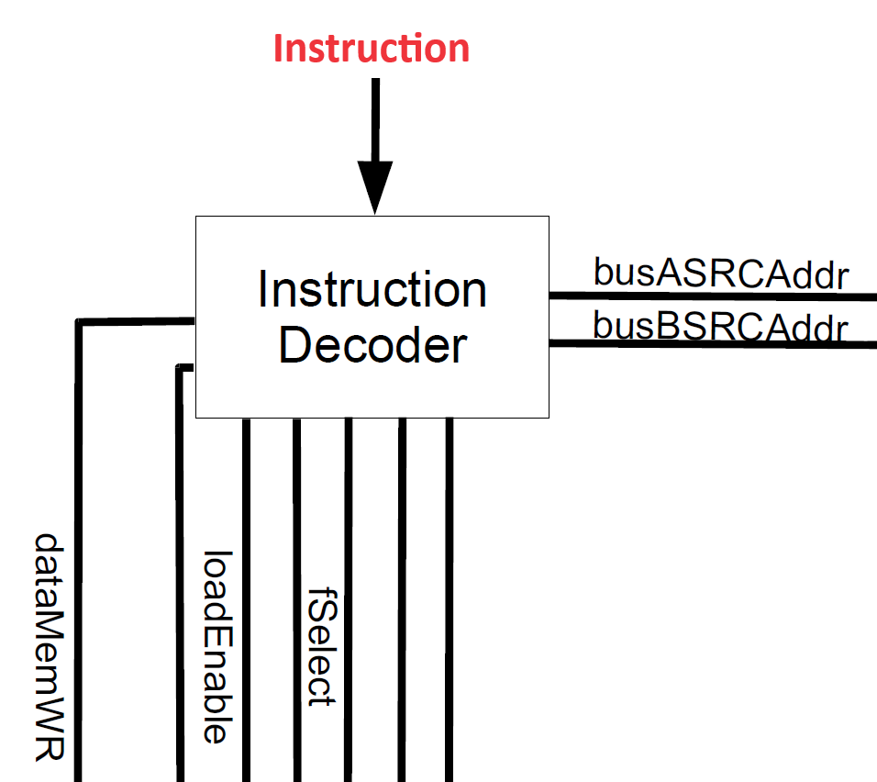
The Instruction Decoder
When you input a pattern, it outputs another pattern. Sounds like a memory, no?

Slide 6
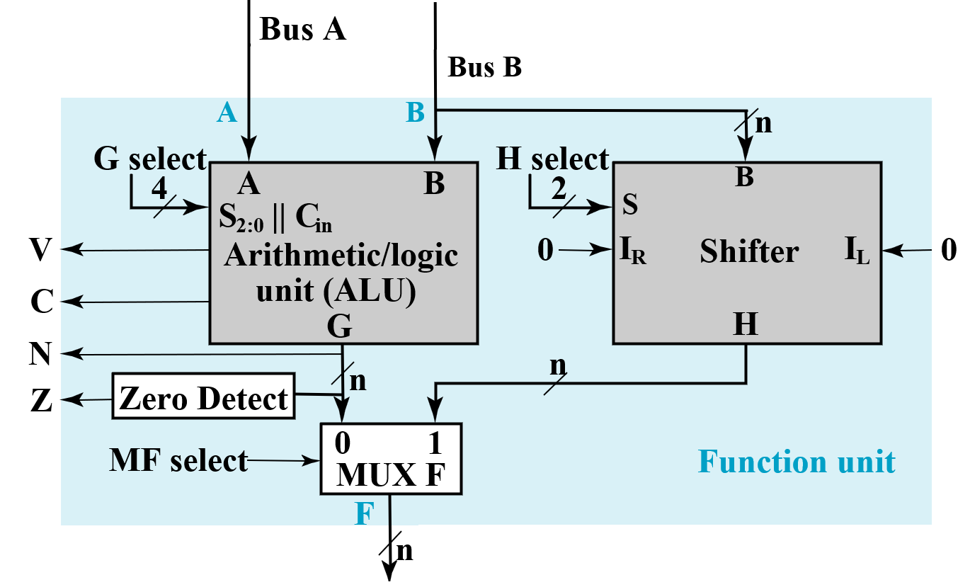
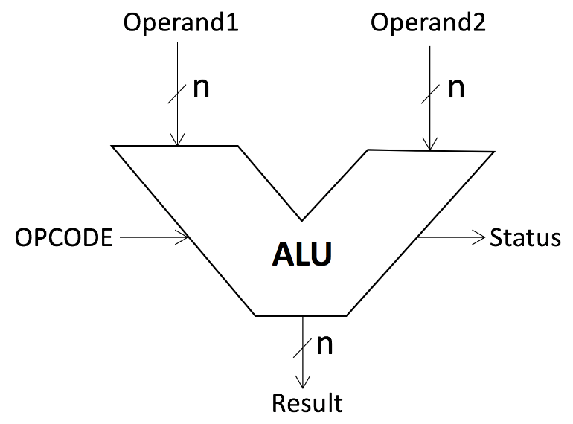
The ALU/Function Unit
Functional units are a part of a CPU that performs the operations and calculations called for by the computer program.
Performs arithmetic and logic operations
  Add, subtract, multiply, divide, and, or, not, xor
  Performs right and left shifting along with rolls
  Typically, 2 buses as inputs and one output bus

Slide 7
Condition Code Bits
N bit is set if result of operation in negative (MSb = 1)
  Equal to MSb
Z bit is set if result of operation is zero (All bits = 0)
V bit is set if operation produced an overflow
C bit is set if operation produced a carry

Slide 8
Condition Code Bits – Carry (C)
C bit is set if operation produced a carry
Examples:
1) Addition of two numbers and result does not fit in 16-bits. C is set.
MOV.W #0xFFFF, R4
MOV.W #0x0001, R5
ADD.W R5, R4
2) Subtraction of two numbers and result does not fit in 16-bits. C is set.
(remember subtraction is addition)
MOV.W #0xFFFF, R4
MOV.W #0x0001, R5
INV.W R5
ADD.W #0x0001, R5
ADD.W R5, R4
3) Addition of two numbers and result fits in 16-bits. C is not set.
MOV.W #0x7FFF, R4
MOV.W #0x0001, R5
ADD.W R5, R4

Slide 9
Condition Code Bits – Overflow (V)
V bit is set if operation produced an arithmetic overflow.
  Set if addition of two positive numbers result in a negative number
  Set if the addition of two negative numbers result in a positive number
  Reset otherwise
Examples:
1) Addition of two negative numbers and result is positive. V is set.
MOV.W #0x8001, R4 ; -32767d
MOV.W #0x8001, R5 ; -32767d
ADD.W R5, R4
2) Addition of two positive numbers and result is negative. V is set.
MOV.W #0x7FFF, R4 ; 32767d
MOV.W #0x0001, R5 ; 1d
ADD.W R5, R4

Slide 10
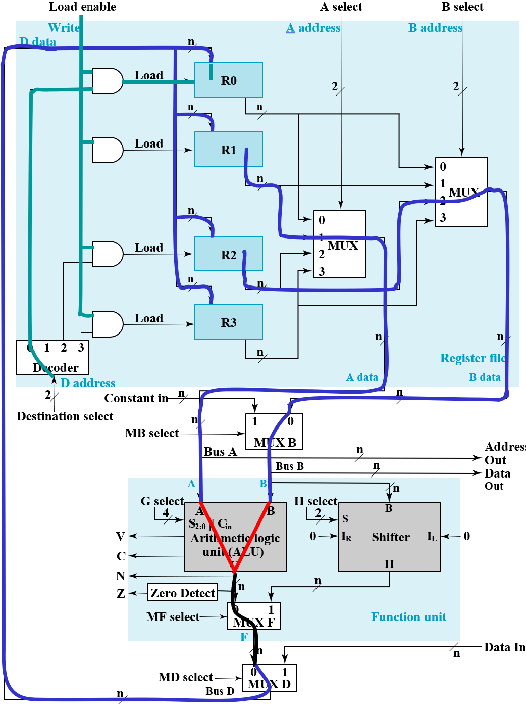
Data Flow
Microoperation: R0 ← R1 + R2
Apply 01 to A select to place
contents of R1 onto Bus A
Apply 10 to B select to place
contents of R2 onto B data and
apply 0 to MB select to place
B data on Bus B
Apply 0010 to G select to perform addition G = Bus A + Bus B
Apply 0 to MF select and 0 to MD
select to place the value of G onto BUS D
Apply 00 to Destination select to enable the Load input to R0
Apply 1 to Load Enable to force the Load input to R0 to 1 so that R0 is loaded on the clock pulse (not shown)
The overall microoperation requires
1 clock cycle

Slide 11
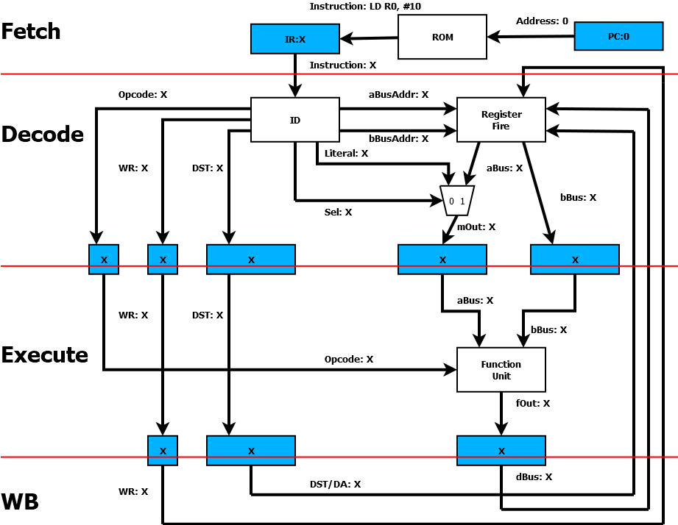
Pipeline Example (CLK0)

Slide 12
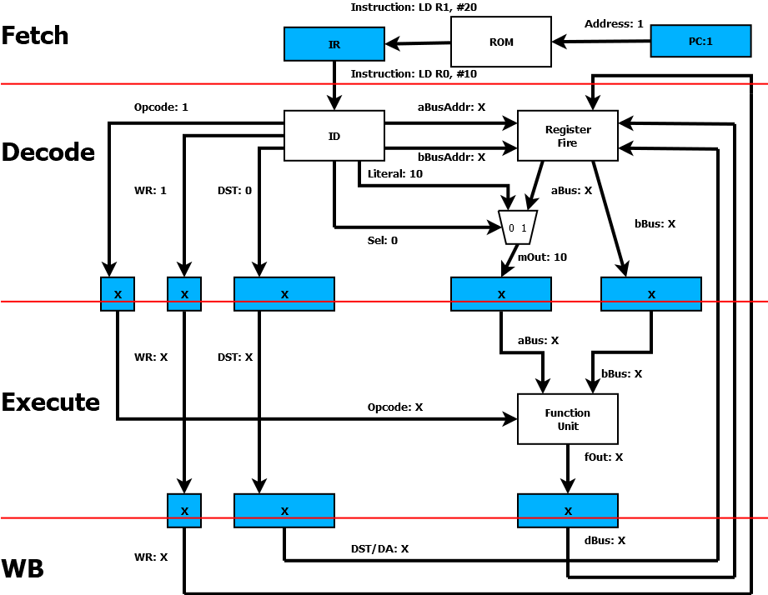
Pipeline Example (CLK1)

Slide 13

Pipeline Example (CLK2)

Slide 14

Pipeline Example (CLK3)

Slide 15

Pipeline Example (CLK4)
3

Slide 16
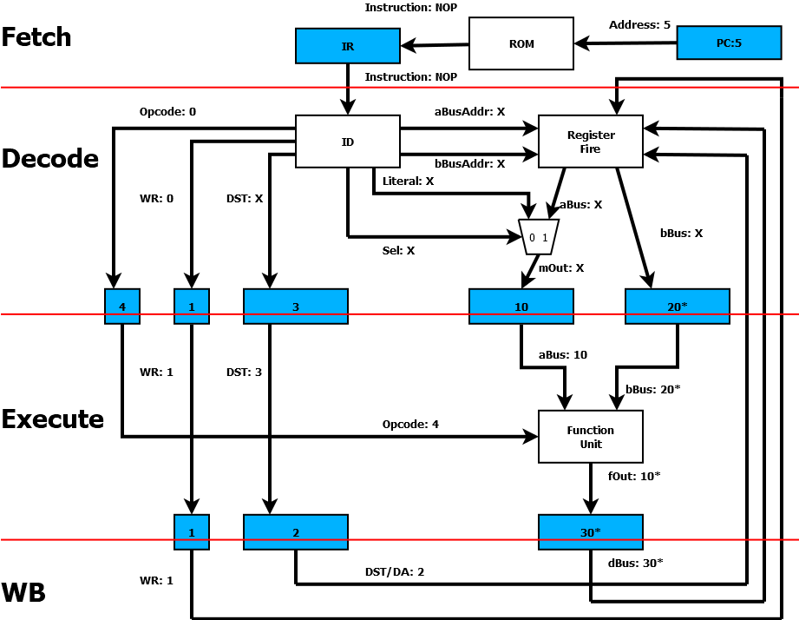
Pipeline Example (CLK5)

Slide 17

Pipeline Example (CLK6)

Slide 18
Sources
http://www.eecs.harvard.edu/cs146-246/
Assigned Textbook
https://en.wikipedia.org/wiki/Instruction_pipelining
https://cstaleem.com/pipelining-and-non-pipelining
https://www.cise.ufl.edu/~mssz/CompOrg/CDA-proc.html#:~:text=Processor%20(CPU)%20is%20the%20active,%2C%20registers%2C%20and%20internal%20buses.
https://en.wikipedia.org/wiki/Superscalar_processor
http://www.eecs.harvard.edu/cs146-246/
Assigned Textbook
https://www.javatpoint.com/functional-units-of-digital-system#:~:text=Functional%20units%20are%20a%20part,for%20by%20the%20computer%20program.
https://en.wikichip.org/wiki/File:sram_basic_cell.svg

